Slide 1
Understanding Costs
September 29, 2022
Wenchen Wang
Notes:
What does it cost?
It depends!
Variety of factors
As managers work on the preparation of plans, one of the critical requirements is a good understanding of costs. The better managers understand costs, the more accurate their plans will be. Furthermore, a solid understanding of costs will improve a manager’s ability to make effective decisions

Slide 2
Last Week
Special Types of Budget
Budgeting Techniques
Budgeting Formats
Forecasting
Subjective Forecasting
Quantitative Forecasting
Notes:
Budgeting techniques: Flexible budget; Zero-based budget; Performance budget
Budgeting formats: Line-item budget; Responsibility center budget; Program budget; Functional budget
Subjective forecasting: The nominal group approach; Delphi techniques
Quantitative forecasting: Causal Models; Time-series Models

Slide 3
Learning Objectives
Cost Definitions
Incremental Cost Analysis
Break-even Analysis
Cost Measurement
Notes:
Define different concepts of cost
How costs change as volume changes. As part of the planning process, organizations must decide whether it makes sense to expand or contract volume, or whether to add or eliminate services. The relationship between costs and volume has a dramatic impact on the profits or losses incurred by an organization.
Then break-even analysis, a technique that assists the manager in determining what volume of activity is required for a program or service to become financially self-sufficient.
Then we will talk about cost measurement/allocation. We will also talk about activity-based costing, a technique designed to improve the accuracy of cost measurements.

Slide 4
Cost Definition: Key Terms
Cost: Amount paid to obtain resources for the organization’s desired use
Relevant costs: Costs that have an impact, or are impacted by, the decision being considered.
Cost Objective:
The focus of the cost analysis
Unit of service, a program, or a department
Time Frame:
Period of estimation
Volume:
Number of units
Notes:
Cost objective: Anything for which a measurement of cost is desired. This could be a unit of service, program, department, or organization. Snow plowing example, only reporting the cost to plow the snow vs. reporting both this cost and the cost of filling the holes caused by the snowplows. Need to clearly define and communicate the cost objective.

Slide 5
Concepts: Direct and Indirect cost
Full cost = direct cost + indirect cost
Full cost: All the costs associated with the cost objective.
Direct Costs:
Cost incurred within an organizational unit
Cost of resources used directly to provide a good or a service
Indirect Costs/Overhead:
Costs that are assigned to a unit from outside.
Costs of resources not used directly to provide service.
Notes:
Costs are often measured both in total and per some unit of measurement. If by total, then it Is full cost-- The total of all costs associated with a cost objective. This includes direct and indirect costs.
Direct and indirect costs’ definitions relate to the object of the analysis. Depending on cost objectives, a specific cost can be measured as both a direct cost and an indirect cost for the same organization
E.g., if one is interested in the direct cost per mile of road plowed (i.e., what it costs to plow the roads), that would include the plow, the driver, and the cost of the salt spread on the road. However, in the direct cost of the Public Works Department, it is appropriate to include department supervisory personnel in that cost, since the supervisors are direct costs of the Public Works Department (i.e., what it costs to operate the Public Works Department). The various scheduling and other administrative activities carried out by supervisory personnel are essential to running the department.
In direct costs are the ones that are not directly related to the cost objectives of the organizations. E.g. the cost of supervisory personnel in the snow plowing example.
Indirect costs are often referred to as overhead. In some instances, only the indirect costs generated outside the department are considered to be overhead. In other cases, all indirect costs may be referred to as overhead.
Managers should explicitly define the cost objective, the types of costs being treated as direct, and those being treated as indirect.

Slide 6
Concepts: Average costs
Average Cost is the total cost of a cost object divided by the number of units of output/volume provided.
Example:
It costs $10,000 to produce 100,000 gallons of water. What is the average cost?
Total Cost = 10,000 = $0.1/gallon
Units of units 100,000
Notes:
Average cost = Cost per unit. Eg, for snow plowing, the total cost could be divided by the number of miles to find the cost per mile plowed.

Slide 7
Concepts: Fixed and Variable Costs
Full cost = Fixed Costs + Variable Costs
Fixed Costs: costs which remain (relatively) unchanged in total for some time period as the volume of services changes over a relevant range of activity.
Variable Costs: costs that vary directly with changes in the volume of service units over a relevant range of activity.
Step Fixed Costs costs that are fixed over ranges of activity that are less than the relevant range.
Mixed Costs contain fixed and variable costs elements
Notes:
Fixed costs: are only fixed within the relevant range for an activity. Eg of fixed cost fee for renting the bus for the relevant range of certain amount of people per bus. Also only fixed over a relevant period. Rent and salary increase after a year.
Step Fixed/Step Variable costs: A step fixed cost is a cost that does not change within certain high and low thresholds of activity, but which will change when these thresholds are breached. Also called semi-variable cost/semi-fixed cost.
Variable costs: camp fees per person. It is important to remember that with additional output, it is the total variable cost that increases if there are variable costs. The per-unit variable cost does not change

Slide 8
Fixed and Variable Cost
Fixed and Variable Cost Example
Fixed Costs
Variable Costs
Notes:
Fixed cost is set at 15 no matter how much is the volume
How much is the variable cost?

Slide 9
Fixed and Variable Cost Example
Full Cost = Fixed Costs + Variable Costs
Full Cost = $40,000 FC + ($5 VC x Volume)
Variable Cost
Notes:
Note that the total costs start at $40,000, even at a volume of zero, due to the fixed costs amount.
Full cost here is also a mixed cost example

Slide 10
Average Cost Example
Average Cost = Total Cost/Volume
Total Cost = $40,000 FC + ($5 VC x Volume)
Notes:
The cost declines as the volume increases because more units are sharing the fixed costs. Because fixed costs do not change in total, the cost per unit does change as volume changes.
Break down the formula to show total cost change per unit. Show on board.
The impact of sharing fixed costs over increasing levels of volume is referred to in economics as short-run economies of scale.

Slide 11
Step-Fixed Cost Example
Step-fixed cost
Notes:
Show line graph on the board.

Slide 12
Fixed and Variable Costs Example
Quick Inoculations Center (QIC) provides early childhood checkups and vaccinations for children. It pays annual rent of $25,000 and has a permanent staff consisting of a nurse practitioner and an administrative assistant, who are paid $125,000 in total per year. QIC hires doctors on a per diem basis to provide exams and uses $15 worth of supplies for each exam, not including vaccines. Inoculation appointments are scheduled in advance, and QIC needs one per diem doctor for every 100 children it has scheduled on any given day. It also spends $7.50 per child for the vaccines used in its inoculations program. Which of QIC’s expenses are
Fixed costs,
step-fixed costs, and
Variable costs?
Notes:
Per diem most commonly refers to a fixed daily allowance an organization provides to employees or contract workers to cover business travel expenses.
Fixed: rent, salary for nurse practitioner and an administrative assistant.
Variable: supplies, vaccination fee
Step-fixed cost: doctor salary

Slide 13

Concepts: Marginal Cost
Marginal cost: The additional cost of adding one additional unit of good or service.
Marginal Cost =
Marginal Cost = Variable cost + Increase in Fixed Cost
Example:
In the previous QIC example, what is the variable and marginal cost of doing exams on the 101st child for the center?
Notes:
At first, marginal costs appear to be identical to variable costs. In both cases, if there is one more unit of activity there will be an increase in total cost due only to the variable costs. Marginal costs, however, more broadly look at all costs that might change as a result of a decision.
In other words, marginal cost is equal to variable cost unless the relevant range of an existing fixed resource is exceeded, in which case marginal cost is equal to variable cost plus new fixed costs.
E.g. QIC needs one per diem doctor for every 100 children it has scheduled on any given day. If QIC hires another doctor to do exams on the 101st child on any given day, then on the margin, which is from doing the exam on the 100th child to the 101st child, the increase in total cost of the additional child is the variable cost of doing exam on one more child plus the cost of hiring another doctor. Therefore, the cost for the marginal child patient would include both the variable costs for that patient and the increase in fixed costs.

Slide 14
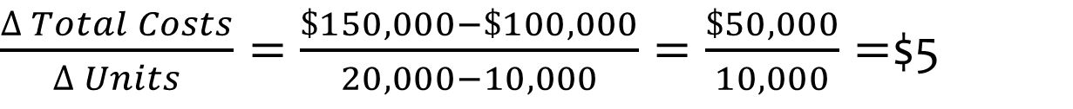
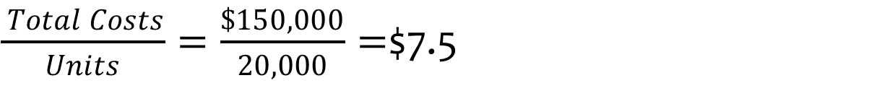
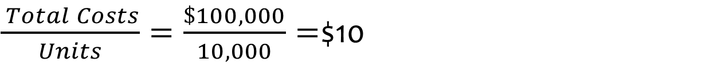
Marginal Cost Example
Example:
It costs $100,000 to produce 10,000 units of a good $150,000 to produce 20,000.
What is the average cost of producing 10,000 units?
What is the average cost of producing 20,000 units?
What is the marginal costs?
$\frac{ Total Costs}{Units}=\frac{\$100,000}{10,000}=$$10
$\frac{ Total Costs}{Units}=\frac{\$150,000}{20,000}=$$7.5
$\frac{∆ Total Costs}{∆ Units}=\frac{\$150,000−\$100,000}{20,000−10,000}=\frac{\$50,000}{10,000}=$$5

Slide 15
Incremental Cost Analysis
COSTS
Incremental cost (IC)
Change in cost due to a quantity change
IC=ΔTC = Δ FC + ΔVC
If Δ FC = 0, IC = ΔVC
Marginal cost (MC)
The incremental cost for unit change in quantity
MC = Δ TC/Δ Q
REVENUE
Incremental revenue (IR)
The change in revenue:
IR=ΔR
Marginal revenue (MR)
The incremental revenue for unit change in quantity
MR = Δ Revenue/Δ Q
MC MR
Notes:
The cost of providing an additional unit of output
The essence of the approach is that decisions such as whether to provide a service or to change the volume of a service should be based on marginal rather than average costs.

Slide 16
Incremental Cost Analysis
The urban planner for the City of Minneapolis is working on a housing project.
The fixed costs are $500,000 for the project
The variable costs are $325 each time a family moves into an apartment.
The housing project now has 1,000 move-ins per year. To encourage the town to expand the program, the state offers to pay $300 for each of 500 move-ins if they expand to 1,500 per year.
Should the town expand the housing project?
 | Fixed Costs | Variable Costs | Total Costs | Average Cost
500
1000
1500

Slide 17
Incremental Cost Analysis
 | Fixed Costs | Variable Costs | Total Costs | Average Cost
500 | $ 500,000 | $ 162,500 | $ 662,500 | $ 1,325
1000 | $ 500,000 | $ 325,000 | $ 825,000 | $ 825
1500 | $ 500,000 | $ 487,500 | $ 987,500 | $ 658
A: how much is the incremental cost?
B: Marginal cost?
Notes:
IC = $162,500
MC = $325

Slide 18
Incremental Cost Analysis
 | Fixed Costs | Variable Costs | Total Costs | Average Cost
500 | $ 500,000 | $ 162,500 | $ 662,500 | $ 1,325
1000 | $ 500,000 | $ 325,000 | $ 825,000 | $ 825
1500 | $ 500,000 | $ 487,500 | $ 987,500 | $ 658
C: how much is the incremental revenue?
D: Marginal revenue?
Notes:
IR = $150,000
MR = $300

Slide 19
Incremental Cost Analysis
Incremental analysis:
Should the town expand the housing project?
At what price does the town expand the project?
What if the state offers to pay $400 each?

Slide 20
Break-Even Analysis
Analyze if a new/continuing project is profitable
Problem: Determine the cost per unit
Break-even analysis:
Determine the volume at which the activity moves from losing money to making money
Notes:
Break-even analysis is a useful tool for assessing whether it is profitable for the organization to adding new projects and ventures as a way of improving the financial stability and results of the organization and subsidizing other activities of the organization that lose money, and it is good for when there is a specific price associated with the service.
The goal of break-even analysis is to determine the volume at which the activity moves from losing money to making money. Understanding whether a particular unit or output will lose money, make money, or just break even is useful for the evaluation of both new and continuing projects and services.
The profitability of an activity is determined by whether its revenues are greater than its expenses. If revenues exceed expenses, the organization earns a profit. If revenues are less than expenses, the organization incurs a loss. Only when revenues are exactly equal to expenses does the activity or organization break even.
An activity’s or organization’s revenues are the average price collected multiplied by the number of units of service.

Slide 21
Break-Even Analysis
Total Revenue = Total Cost/Expenses
Total Revenue = Fixed Costs + Variable Cost
P*Q = FC+ VC*Q
P*Q - VC*Q = FC
Q(P – VC) = FC
Q= FC
(P – VC)
BEQ= FC
(P – VC)
BEQ= FC-FR
(P – VC)
Contribution Margin
Notes:
The intuition of break-even analysis is expressed by the break-even formula: It is a ratio of fixed costs to the contribution margin. The higher the ratio, the more volume or output that is required to cover the fixed costs. And of course, the lower the ratio, the less volume or output that is required. Once the fixed costs are covered, an organization can profit.

Slide 22
Break-Even Analysis
There is a student association planning for a fundraising event. They will have a band as entertainment for a fee of $750. The event will be in a museum that charges $600 for the use of the banquet room. A restaurant was selected for catering, it charges a flat fee of $400 and $ 20 per meal
The student association expects 250 students and alumni to attend to the event. What is the minimum break-even ticket price for the event?
The association is considering two ticket prices, a $25 price for students and $75 price for alumni. If three students are expected to attend for each alumni, how many students and alumni must attend to the event if it is to break even?
Notes:
1750 + 20*250 = 250*X => X = $27
1750 + 20*4Y = 75*Y + 25*3Y => Y = 25

Slide 23
Break-Even Analysis
variable cost
BEQ
Notes:
Left-hand side of the intersection is the losses
Right-hand side of the intersection is the profits

Slide 24
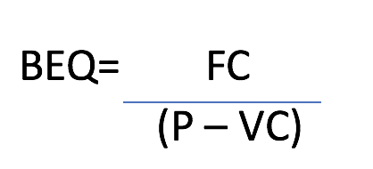
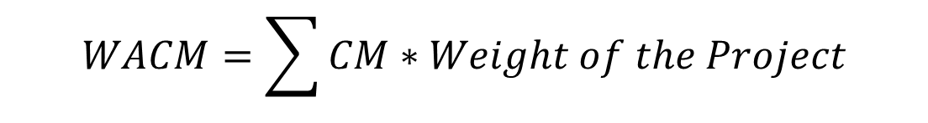
Break-Even With Multiple Products
BEQ= FC
WACM
Weighted Average Contribution Margin
Contribution Margin
$$WACM=\sum{CM∗Weight of the Project}$$
Notes:
Solve for FC P and vC
Judgement is essential

Slide 25
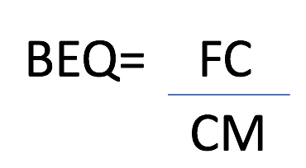
Break-Even With Multiple Products
Ran three regional programs with $250,000 of fixed costs and the mix of contributions shown below: What would the break-even volume be?
Program | Donation | Variable Costs
Program A | 250 | 100
Program B | 400 | 388
Program C | 100 | 99
Total | 750
Contribution Margin
150
12
1
Percentage of Donations
33.33%
53.33%
13.33%
Weighted Average CM
50
6.40
0.13
56.53
= $250,000 / 56.53 = 4,422 donations
over a time (year) to cover all of the costs

Slide 26
Break Even Analysis Example
A hospital has 4 departments: Pediatrics, orthopedics, gynecology, and neurology.
Fixed cost is $1,451,000.
What would be the break-even number of patients per department?
Program | Fee per patient | Variable Costs | Percentage of Patients
Pediatrics | $40 | $25 | 14.81%
Orthopedics | $50 | $39 | 18.52%
Gynecology | $80 | $47 | 29.63%
Neurology | $100 | $73 | 37.04%
Total
Contribution Margin
Weighted Average CM

Slide 27
Break Even Analysis Example
A hospital has 4 departments: Pediatrics, orthopedics, gynecology, and neurology.
Fixed cost is $1,451,000.
What would be the break-even number of patients for the hospital?
Program | Fee per patient | Variable Costs | Percentage of Patients
Pediatrics | $40 | $25 | 14.81%
Orthopedics | $50 | $39 | 18.52%
Gynecology | $80 | $47 | 29.63%
Neurology | $100 | $73 | 37.04%
Total
Contribution Margin
$15
$11
$33
$27
Weighted Average CM
$2.22
$2.04
$9.78
$10
$24.04
= $1,451,000/ 24.04 = 60,358 patients
How to get the break-even number of patients for each department?

Slide 28
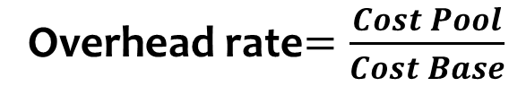
Overhead Rate
Cost Allocation: Allocation of indirect costs from one cost objective and allocating them to other cost objectives
Overhead rate
Cost allocated to a program
= overhead rate*The cost base of the program/department
Cost pool
The total cost to be allocated
Cost base
Measure of an activity that incurs the cost
Overhead rate$=\frac{Cost Pool}{Cost Base}$
Notes:
Cost allocation refers to taking costs from one area or cost objective and allocating them to other areas or cost objectives.
Allocation for direct cost is called direct distribution
A cost pool is any grouping of costs to be allocated. A cost base is the criterion on which the allocation is to be made.
If the base is divided into the cost pool, an overhead rate can be calculated.

Slide 29
Overhead Rate
University of Minnesota Twin-Cities campus pays $250,000 every year to the UMPD for security of the campus. The campus has 50,000 students enrolled across the Graduate and Undergraduate courses. What is the overhead rate?
If 60% of the students are undergraduates, and 40% are graduate students, how much should the university charge for each department?
Cost pool | Cost base | Overhead Rate
Department | Cost base | Overhead Rate | Cost for Dept.
Undergraduate
Graduate

Slide 30
Overhead Rate
University of Minnesota Twin-Cities campus pays $250,000 every year to the UMPD for security of the campus. The campus has 50,000 students enrolled across the Graduate and Undergraduate courses. What is the overhead rate?
If 60% of the students are undergraduates, and 40% are graduate students, how much should the university charge for each department?
Cost pool | Cost base | Overhead Rate
$250,000 | 50,000 | $5
Department | Cost base | Overhead Rate | Cost for Dept.
Undergraduate | 30,000 | 5 | $150,000
Graduate | 20,000 | 5 | $100,000

Slide 31
Activity Based Costing (ABC)
A method of cost allocation
Allocation bases on a careful examination of the cause-effect relationship between activities and costs
It argues that the volume of orders is not the only factor affecting the costs, but rather the activities involved.
Notes:
from one area or cost objective and allocating them to other areas or cost objectives. It attempts to model the production process in an effort to measure costs more accurately. ABC attempts to determine the underlying activities that cause an organization to incur costs and then to assign costs based on the amount of each activity undertaken, rather than using an arbitrary allocation base.

Slide 32
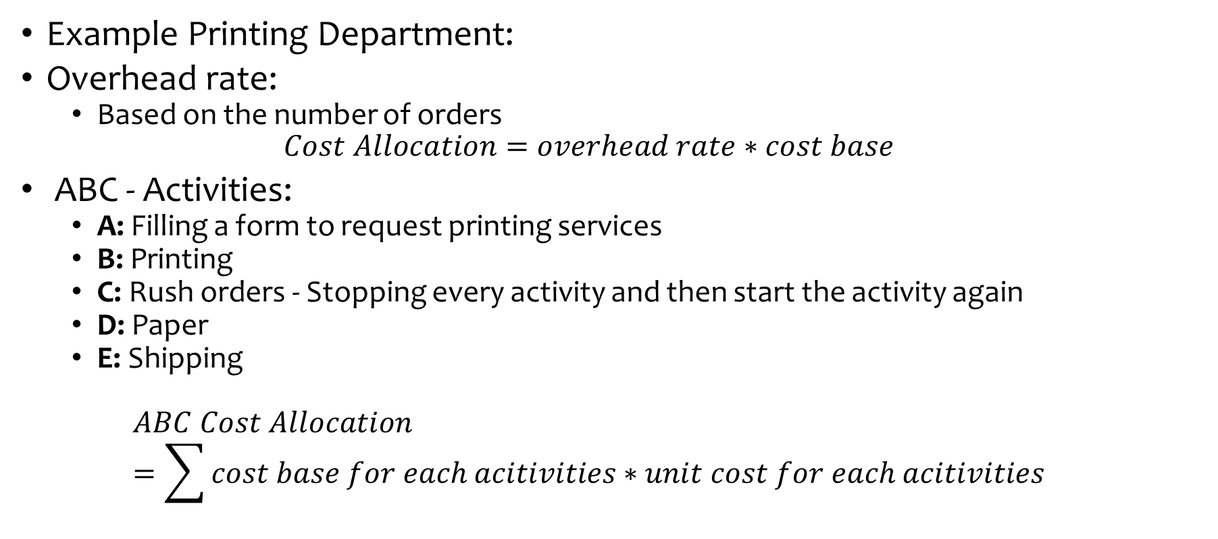
Activity Based Costing (ABC)
Example Printing Department:
Overhead rate:
Based on the number of orders
$$Cost Allocation=overhead rate∗cost base$$
ABC - Activities:
A: Filling a form to request printing services
B: Printing
C: Rush orders - Stopping every activity and then start the activity again
D: Paper
E: Shipping
$$ABC Cost Allocation=\sum{cost base for each acitivities∗unit cost for each acitivities}$$
Notes:
Different costing method may generate different cost allocation results.

Slide 33
Activity Based Costing (ABC)
Printing Department
Total cost: 384,500
Number of orders: 7,400
Orders from the Economics Department: 300
Overhead rate: ?
Cost allocated to the economics department:?
Notes:
384500/7400=52
Cost allocation: 52*300=15,600

Slide 34
Activity Based Costing (ABC)
Activity | Cost
A – Filling form | $1.0
B - Printing | $50
C – Rush order | $2.0
C – Paper | $1.5
D - Shipping | $3.0
Assume that:
4000 regular orders,
2500 rush orders,
400 orders that require other type of paper, and
500 orders require shipping
What would be the cost for the economics department? If they ask for 250 regular orders, 50 rush orders, and all of them require shipping?
ABC Method Cost Allocation:
(300*1) + (300*50) + (50*2) + (300*3)
= $16,300
Overhead Rate Method Cost Allocation:
$15,600
Activity | Cost | Orders | Total
A – Filling form | $1.0
B - Printing | $50
C – Rush order | $2.0
D – Paper | $1.5
E - Shipping | $3.0
TOTAL
7,400
$7,400
7,400
$370,000
2,500
$5,000
400
$600
500
$1,500
$384,500

